Slide 1


Business Strategy Analysis Using Quarterly Earnings Calls
1. Mihir Deshpande (md46487)
2. Muskan Agarwal (ma64547)
3. Rishabh Tiwari (rt27739)
4. Samarth Mishra (sm79247)
5. Sreekar Lanka (sl54387)

Slide 2

What's the Big Question ?
How has change in leadership affected the business strategies and key focus areas for the two biggest tech giants?
Why does it matter ?
It helps us gain further insight into why leaders make the decisions they do and if there really is a 'right' way to strategize
Notes:
To answer this question, we approached this problem from multiple perspectives to capture and analyze changes in their strategies.

Slide 3



Data Source
Quarterly Earnings Conference Call Transcripts from 2005 – 2022 for two tech giants – Google and Apple
But why Earnings Call Transcripts ?
Results and the reason behind results
Key Themes the company is focusing on
Earnings Call
Shareholder information
Future plans and company outlook
Source: Seeking Alpha
Observation Period: 2005 - 2022
Apple Inc. - AAPL & Google - GOOG
Notes:
Lot of quantitative information available,
What can we get from qualitative sources, specifically first hand sources such as earnings calls

Slide 4
Data Preprocessing
Data Preprocessing was needed to highlight differentiating and relevant topics across earnings call that tend to be homogenous and vague
Removing Stop Words and additional terms
Tokenization (using TF-IDF trigrams for LDA)
Extracting sentences from raw transcript text files
Lemmatization
Raw text files containing transcript text with special characters, newline I and end of line identifiers, etc need to be cleaned and processed to get set of legible English sentences
Removed English Stopwords
Removed additional stopword terms determined to be irrelevant heuristically
Removed words identified as Names by spaCy EntityRecognizer
Tokenized all transcripts using TF-IDF values
Included Trigrams in Tokenization
Specifically done to be fed as input to Topic Modelling
Set all words to lower case and lemmatized to generalize the text
Notes:
Make sure to quickly mention entityrecognizer was used to detect and remove names

Slide 5
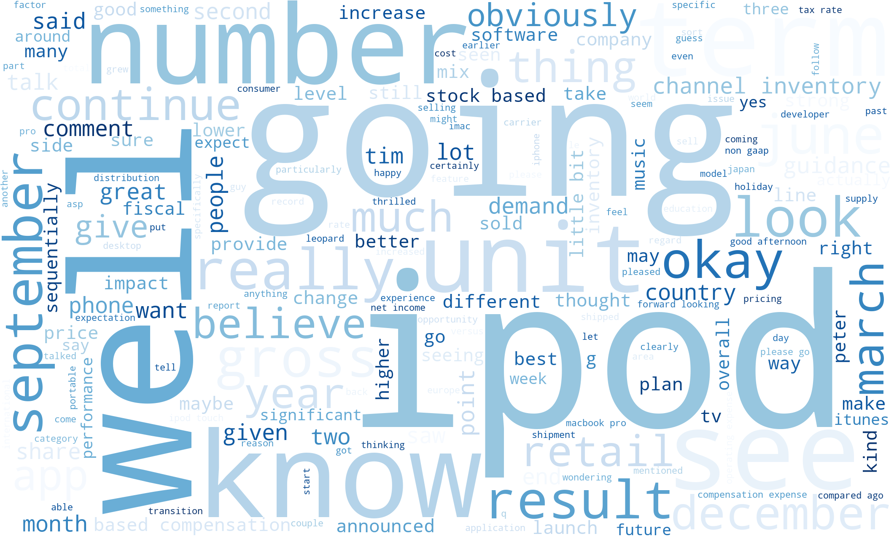
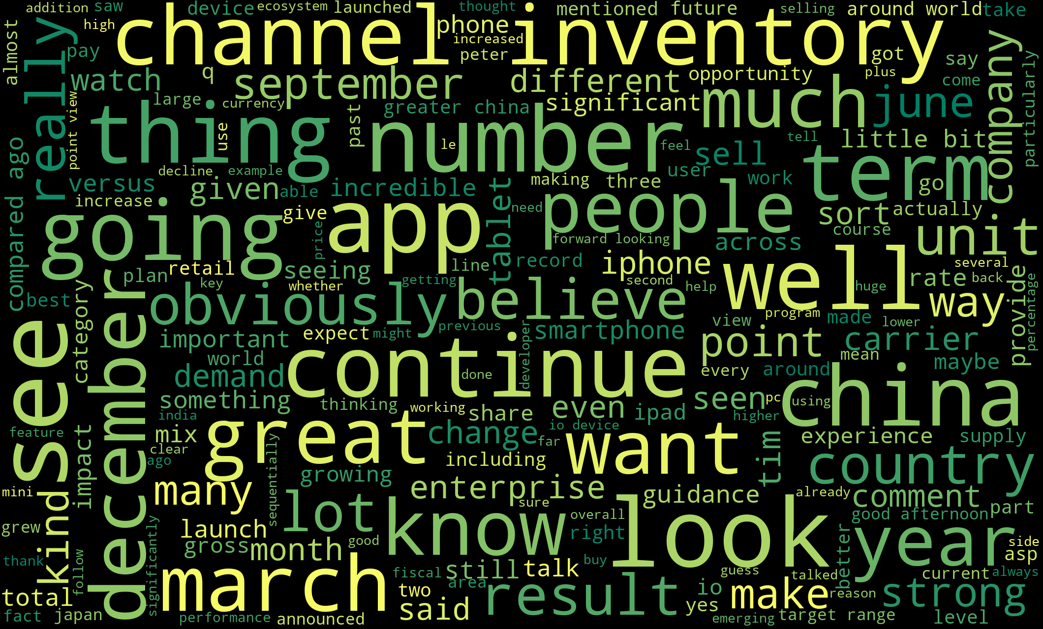
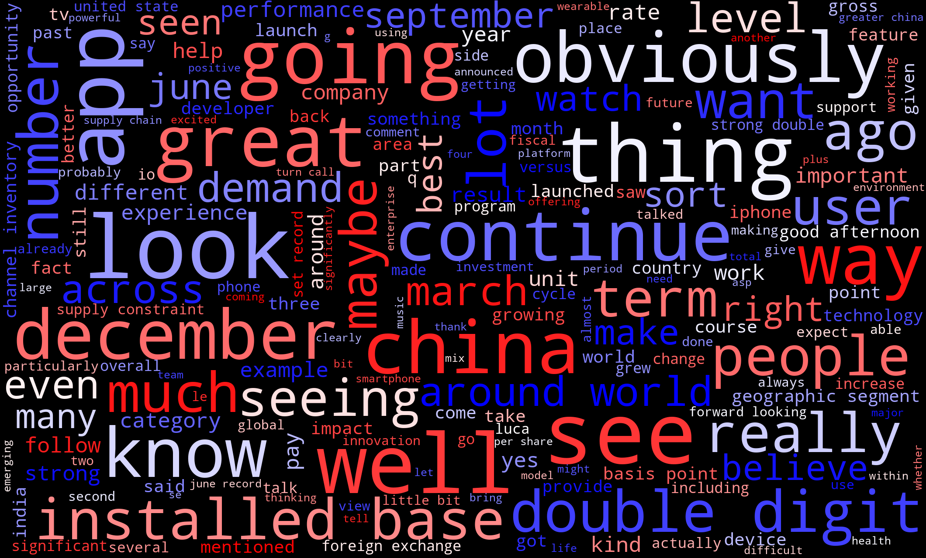
2005
2006
2007
2008
2009
2010
2011
2012
2013
2014
2015
2016
2017
2018
2019
2020
2021
Key Themes - Apple
Before Tim Cook took over as the CEO
During Tim Cook's Leadership
From 2006-11, focus more on software and development of products represented by words such as developer, ipod, mac book, software, retail etc
From 2011-16, the company was focusing on laying a foundation which is represented by the words on the top left image channel, inventory, demand, emerging, app
From 2017-22, the company focused on implementation of the foundations which is represented by words like user, launch, performance, installed.
Notes:
Before tim cook – ipod, retail, iphone
After Tim cook – 1st half – channel, inventory, company, CHINA
2nd half – app, double digit, supply constraint

Slide 6
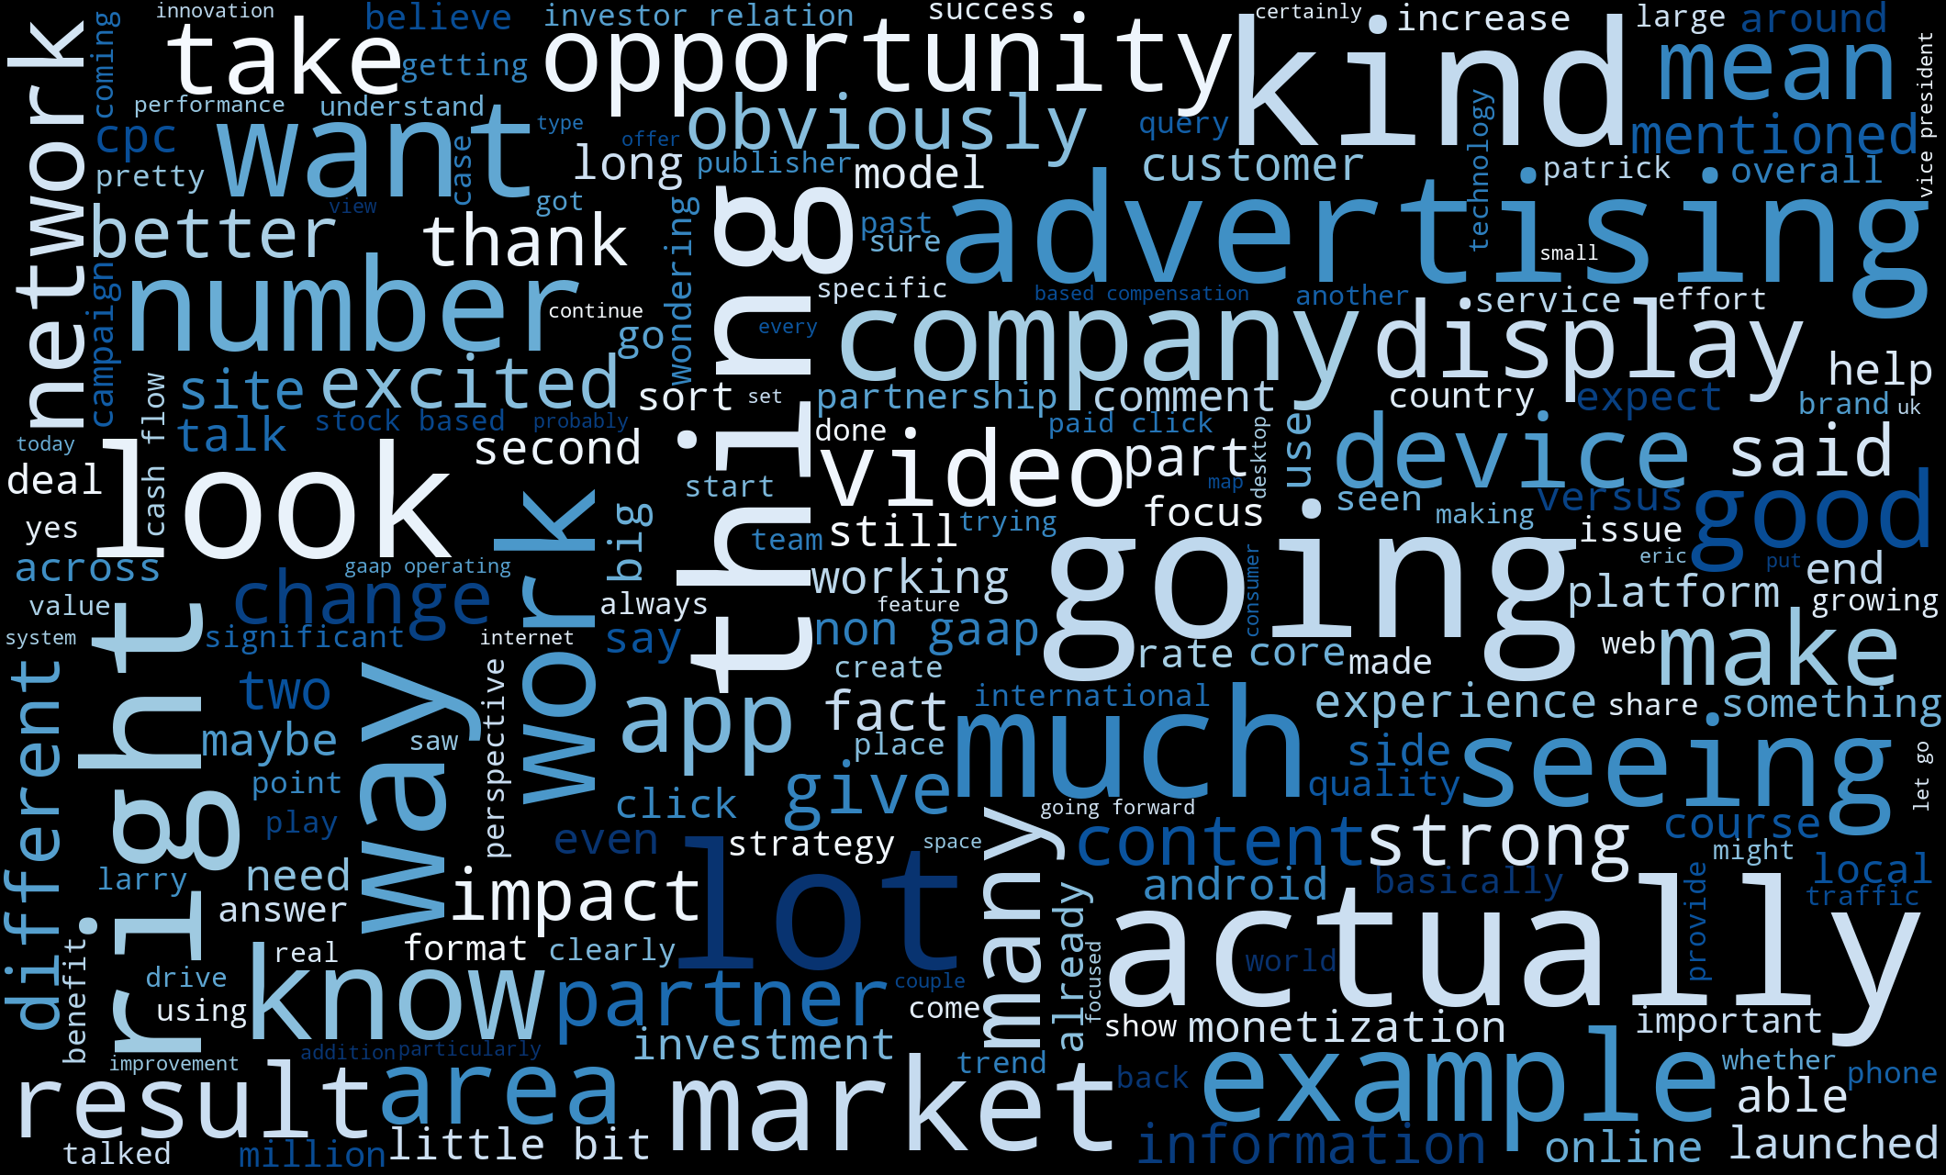
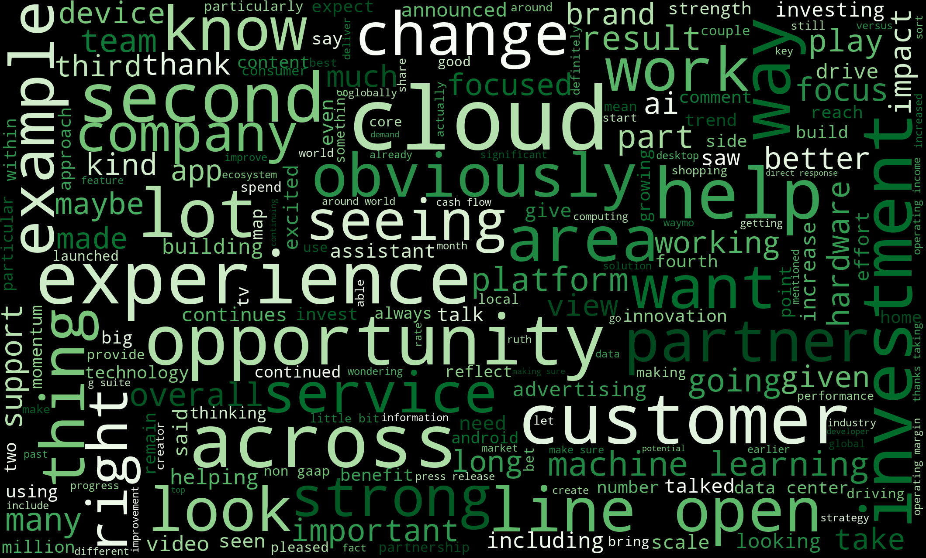
2005
2006
2007
2008
2009
2010
2011
2012
2013
2014
2015
2016
2017
2018
2019
2020
2021
Key Themes - Google
Before Sundar Pichai took over as the CEO
During Sundar Pichai's Leadership
From 2006 – 2015 company was more focused on generating revenue with the aid of advertisements across multiple platforms which can be seen with the word cloud image on the top which has words like advertising, display, platforms etc.
From 2016 – 2022 the company was more focused on working and improvement of cloud, drive, customer service which can be seen with the bottom word count image​
Notes:
Before sundar – Advertising, app, display, network
After sundar – cloud, platform, investment, , ai assistyanty

Slide 7
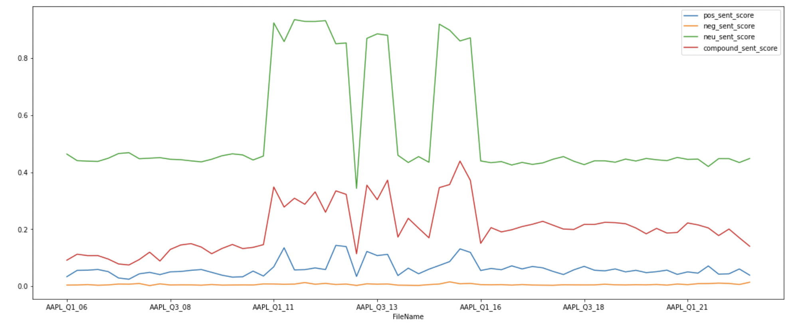
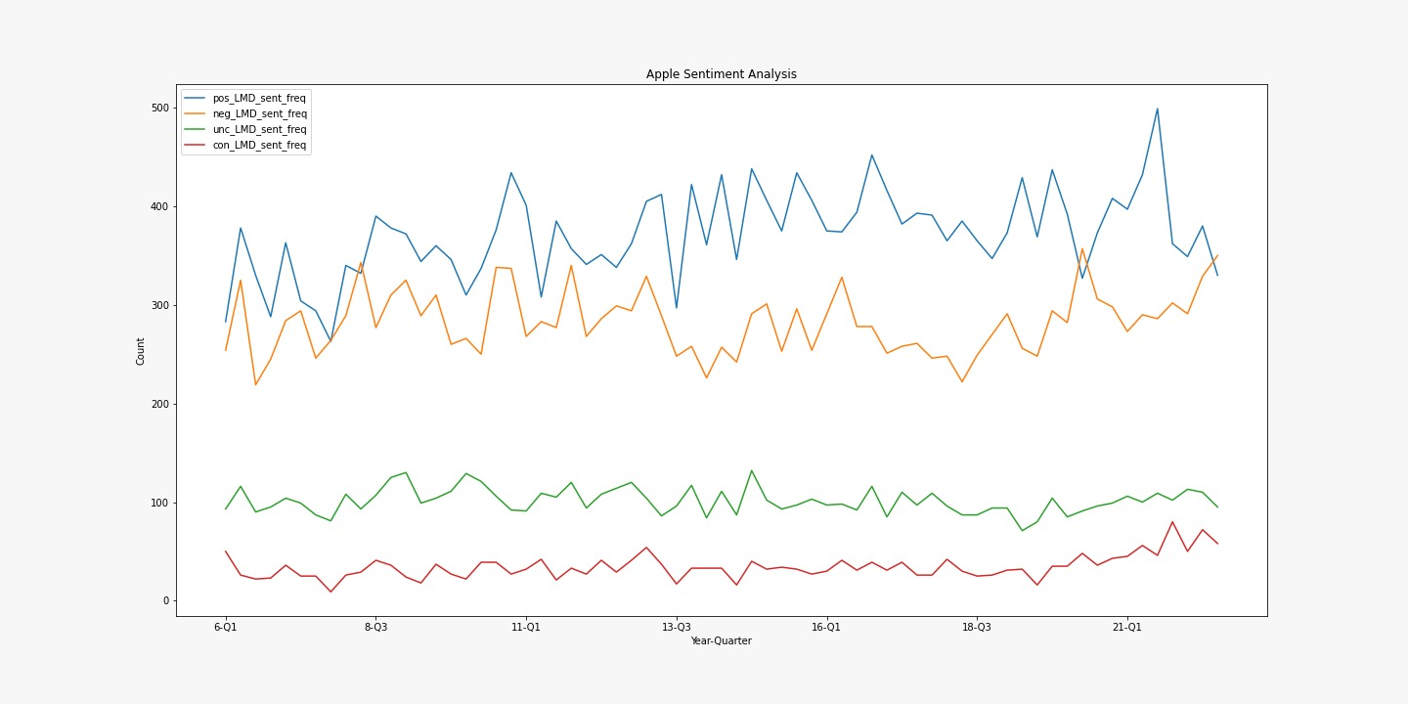
Sentiment Analysis - Apple
Before Tim Cook
During Tim Cook's Leadership
Using Vader
After Tim Cook became the CEO, positive and negative counts of words increased while uncertainty and constraining words remained same
Using Loughran McDonald sentiment dictionary
Notes:
The Loughran and McDonald Sentiment Word Lists were developed using corporate 10-K reports between 1994 and 2008

Slide 8
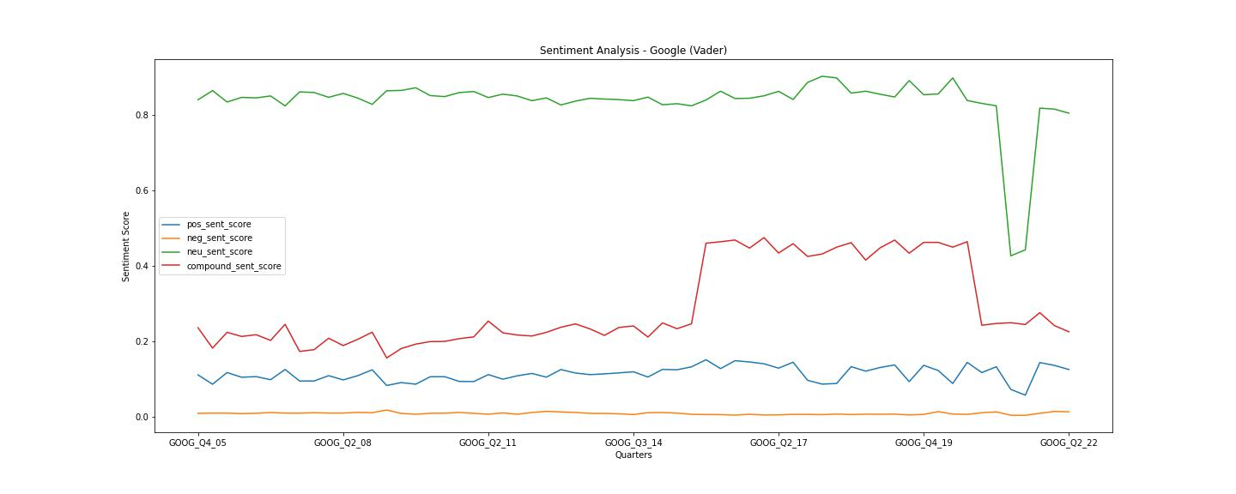
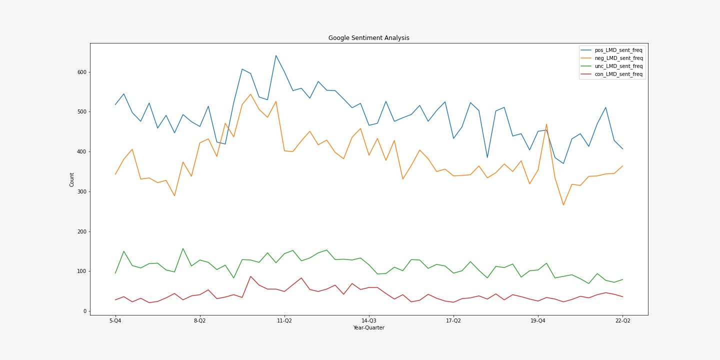
Sentiment Analysis - Google
Before Sundar Pichai
During Sundar Pichai's Leadership
Using Vader
After Sundar Pichai became the CEO, the occurrence of positive and negative (polarizing) terms gradually reduced
Using Loughran McDonald sentiment dictionary

Slide 9
2005
2006
2007
2008
2009
2010
2011
2012
2013
2014
2015
2016
2017
2018
2019
2020
2021
Topic Modelling - Latent Dirichlet Allocation (Apple)
Before Tim Cook took over as the CEO
During Tim Cook's Leadership
Product Innovation: [ 'iphone apple tv', 'commodity pricing environment', 'customer store week', 'environment product mix', 'ipod representing growth', 'new software feature']
Hardware Development: [ 'intel-based mac', 'itunes music store', 'supply demand balance', 'cash stock based']
Mobile Phone Innovation: [ 'iphone apple tv', 'published estimate growth', 'iphone ipod touch', 'long term marketable', 'traditional mp player', 'smart phone market']
Sales Growth: [ 'channel inventory reduction', 'itunes software service', 'iphone iphone plus', 'strong double digit', 'seven-week target', 'sold million iphones', 'satisfaction rate ipad', 'time quarterly record', 'outside united-states']
Revenue Generation: ['double digit growth', 'supply demand balance', 'iphone channel inventory', 'growth geographic segment', 'cash flow operation', 'new product pipeline', 'new time record']
Increase in Profit Margin: ['wearable home accessory', 'set june record', 'service gross margin', 'product gross margin', 'double digit geographic', 'million paid subscription']
Under Steve Job's leadership, the company was very product/innovation focused
Under Tim Cook's leadership, the company was focused on both product and growth/business

Slide 10
2005
2006
2007
2008
2009
2010
2011
2012
2013
2014
2015
2016
2017
2018
2019
2020
2021
Topic Modelling - Latent Dirichlet Allocation (Google)
Before Sundar Pichai took over as the CEO
During Sundar Pichai's Leadership
Global Management: ['paid click growth', 'global sale operation', 'aggregate paid click', 'click growth rate', 'product management global', 'activity remove capital', 'remove capital expenditure']
Advertising Income: ['earnings press release', 'long term growth', 'total advertising revenue', 'excluding stock based', 'earnings diluted share', 'net income billion', 'free cash flow', 'content acquisition cost', 'machine learning ai']
Company Growth: ['advertising revenue billion', 'free cash flow', 'short form video', 'visiting relation section', 'earnings press release', 'query volume growth']
Technological Growth: ['cloud play hardware', 'long term growth', 'machine learning make', 'make mobile web', 'mobile web better']
Customer Experience: [ 'benefit hedging program', 'paid click growth', 'product listing ad', 'consumer online activity', 'description risk factor']
Advertising management: ['total revenue billion', 'total advertising revenue', 'carry higher tac', 'site tac rate', 'sale marketing expense', 'content acquisition cost', 'advertising revenue billion']
Before Sundar Pichai's leadership, the company was focused on revenue generation from various advertisement platforms
Under Sundar Pichai's leadership, the company was focused on improvising cloud services and customer experience

Slide 11
Insights/Takeaways
Indicators
Word Cloud Analysis
Comparison of Apple from period 2005 to 2011 and 2011 to 2022
Insights / Takeaways
Under different leaders, companies operate differently, as their strategies differ.
With Apple Pay, Apple TV and iCloud, as well as the emergence of Apple tv and Apple TV home, Apple has transitioned from major technology to equal distribution in technology and business models.
Comparison of Google from period 2005 to 2015 and 2015 to 2022
Google transitioned towards rapid improvisation of cloud, drive, customer experiences at a rapid pace from being a major advertisement platform
Even though the shift in focus differed drastically after change in leadership in both companies; Apple going for a business expansion and record revenues route and Google focusing on tech innovation, both companies have performed exceptionally well.

Slide 12
Thank you !

